Slide 1
SuperTest
Group I3

Slide 2
What is SuperTest?
All in one solution
Main focus : Curtin SuperLab
Made for both students and examination invigilators

Slide 3
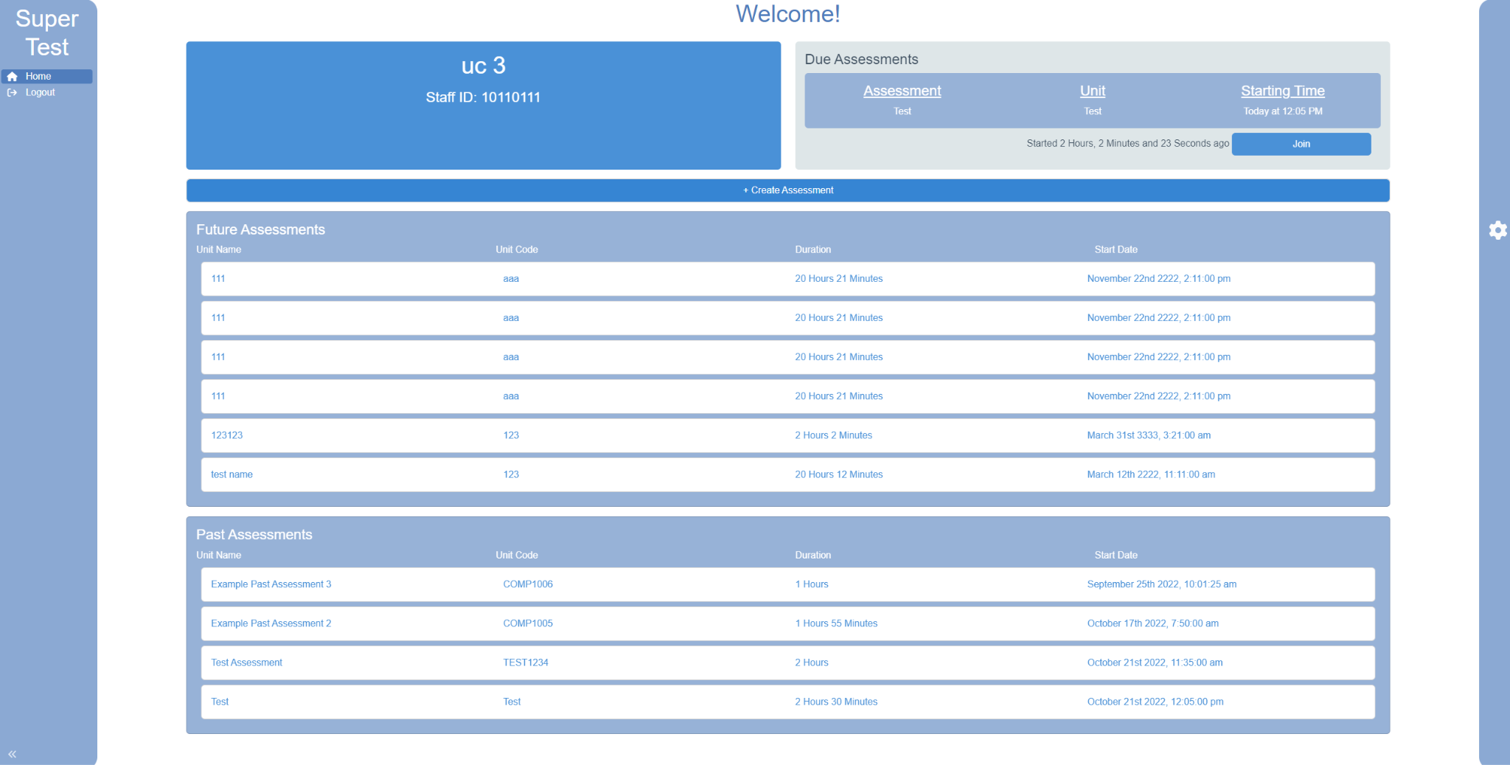
UC Client Dashboard
Join Assessment
Create Assessment

Slide 4
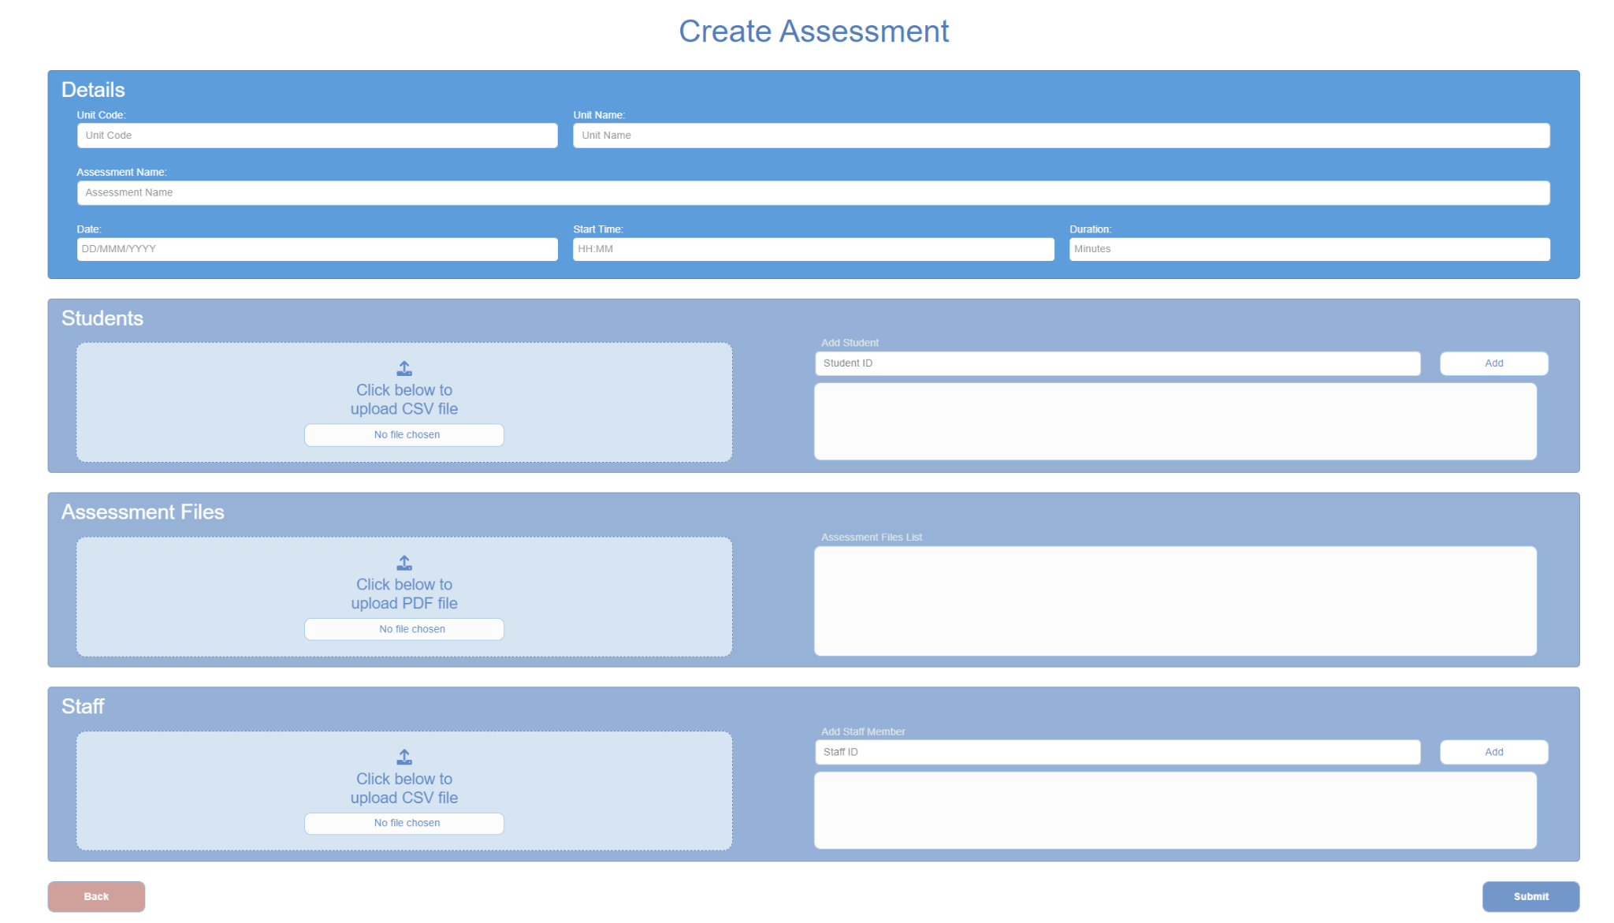
UC Client Create Assessment Tab

Slide 5
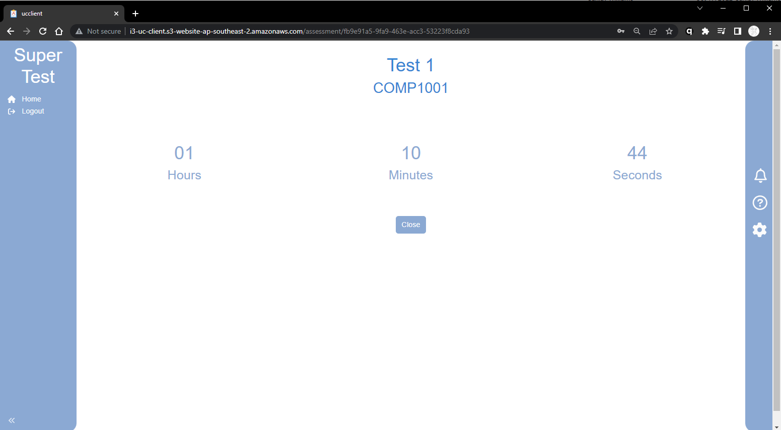
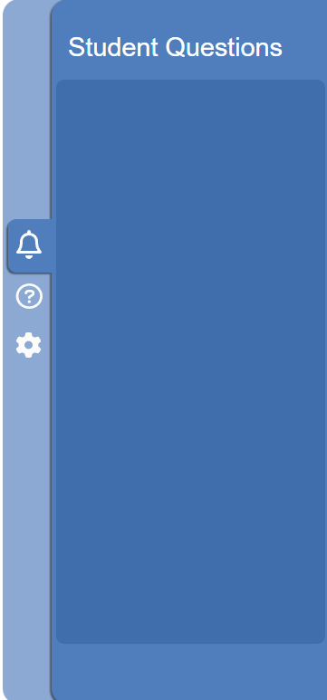
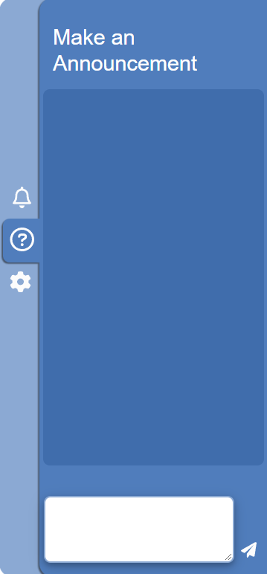
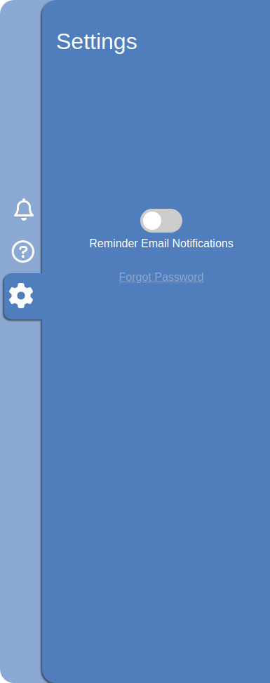
UC Client Current Assessment Tab

Slide 6
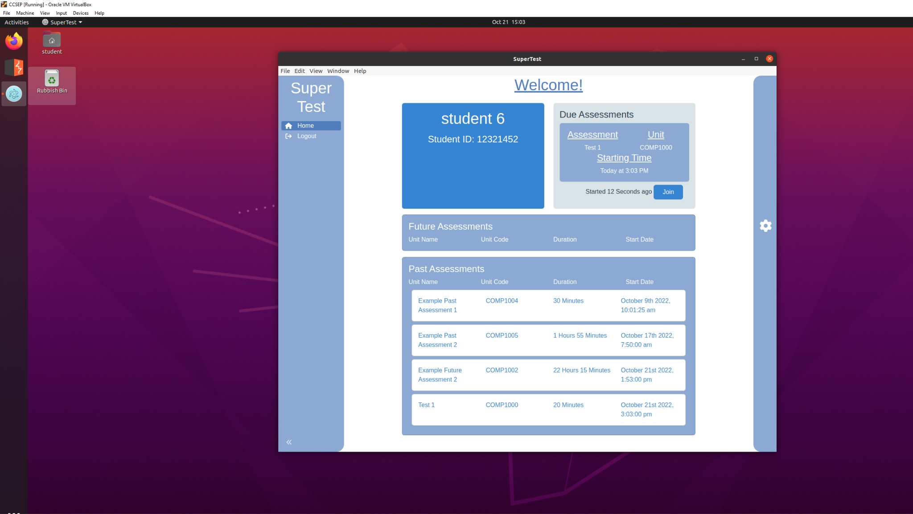
Student Client Dashboard
Join Assessment

Slide 7
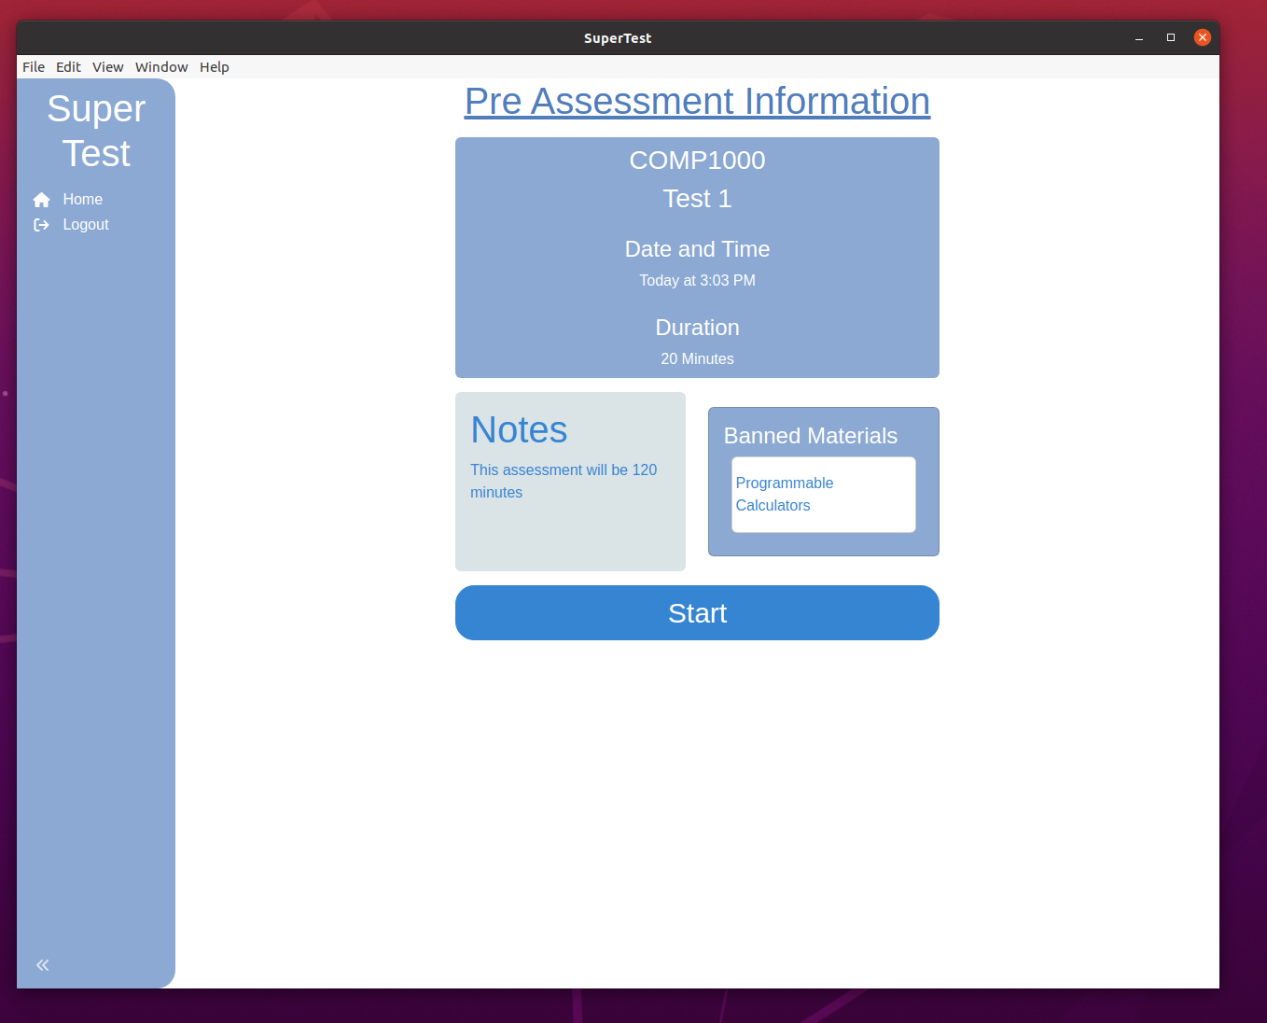
Student Client Pre-Assessment Information

Slide 8
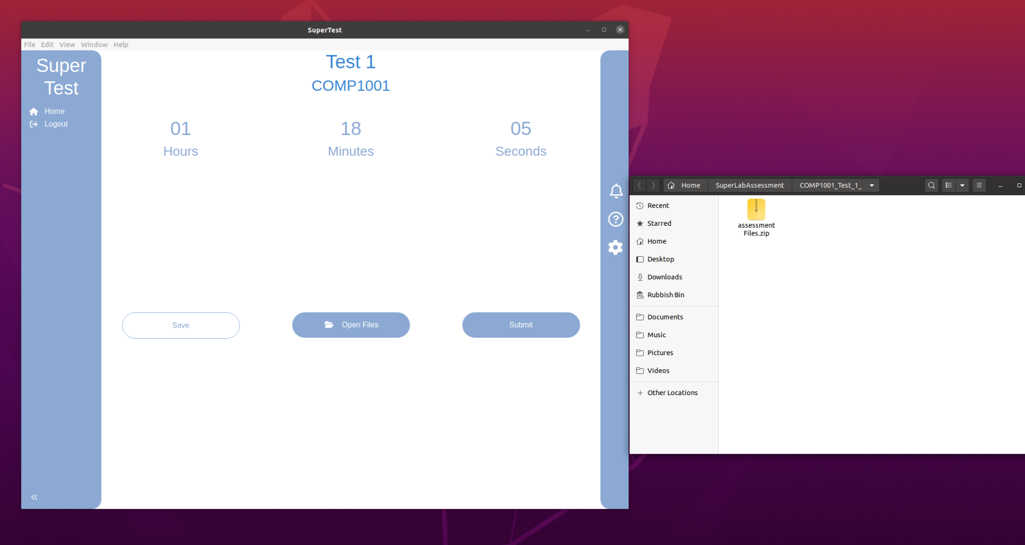
Student Client Current Assessment
Manual Save
Notifications
Access to Assessment Files

Slide 9



Why should you use SuperTest?
Modularity - Open-source licensed by MIT
Data Security - JWT Authentication via Keycloak
Convenience - accessible through Linux + web
Reliability - Rsync file synchronisation

Slide 10
Thank you!

